Slide 1
For Live Session
Unit 7
Chad Madding

Slide 2
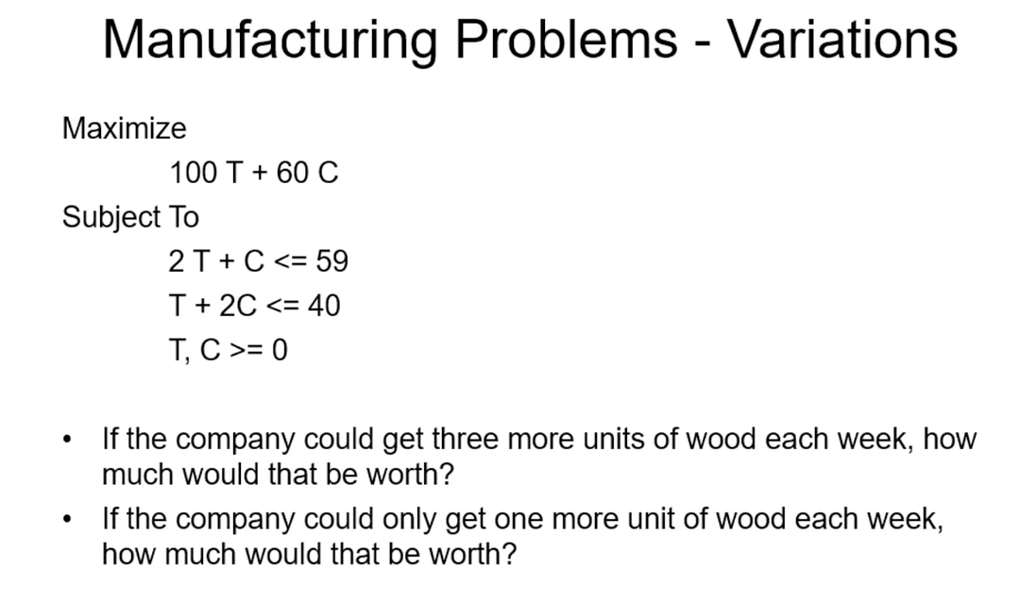
Activity 1: Graphical Method to Solve LP
Keeping with the manufacturing problem (below), make a coordinate plane and plot and use the graphical method introduced by Rusty to solve the problem as it is written below. You may plot this by hand on paper and provide a pic or you may use software and provide screen shots.

Slide 3
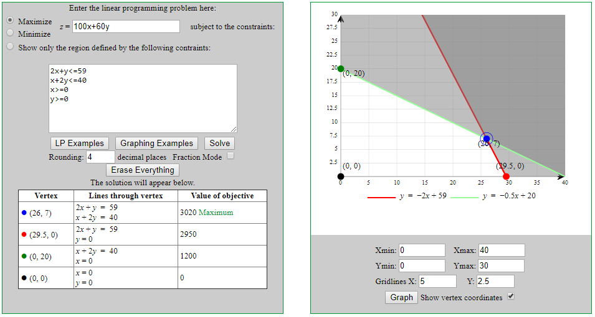
Activity 1 solution: This graph is from: https://www.zweigmedia.com/utilities/lpg/index.html?lang=en

Slide 4
Activity 2: Solve LP
If you have not done so, ”code” in Excel Solver to solve the problems that Rusty Burlingame showed in 7.4. No slide necessary here… this is an exercise to get the practice necessary to master the ideas.
In his Excel Solver video (7.4) Rusty solved the manufacturing problem (tables and chairs). However there were some variations / additional questions asked (make any reasonable assumptions you need to answer to problem). Answer those two questions on a slide or two!

Slide 5
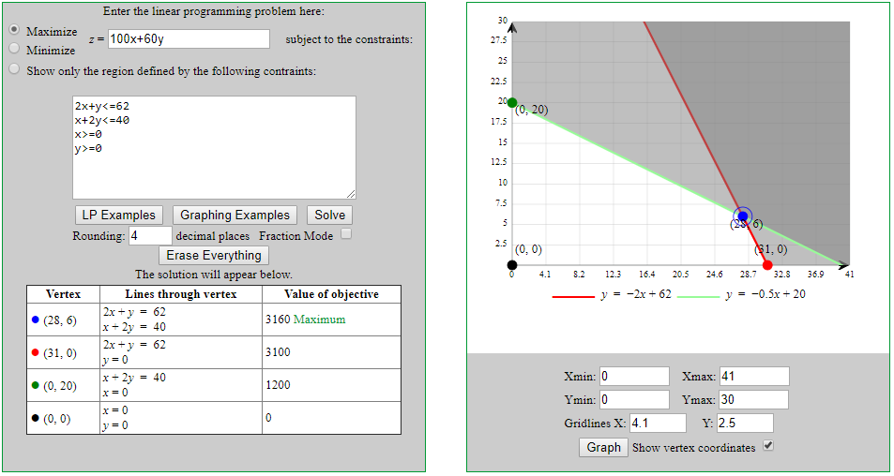
Activity 2 solution A: Three more units of wood would move their total count of wood to 62 and that would be worth $3160. Looking at the original $3020 would mean they would make an extra $140 a week if they could get three more units of wood.

Slide 6
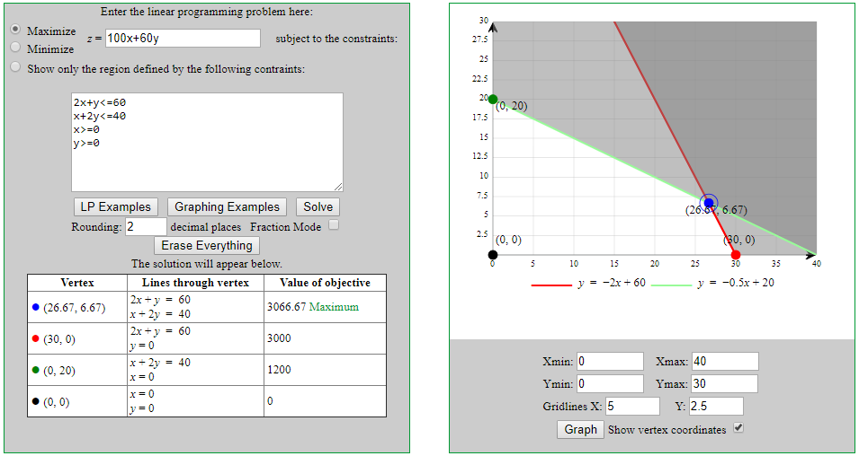
Activity 2 solution B: One more unit of wood would move their total count of wood to 60 and that would be worth $3066.67. Looking at the original $3020 would mean they would make an extra $46.67 a week if they could only get one more unit of wood.

Slide 7
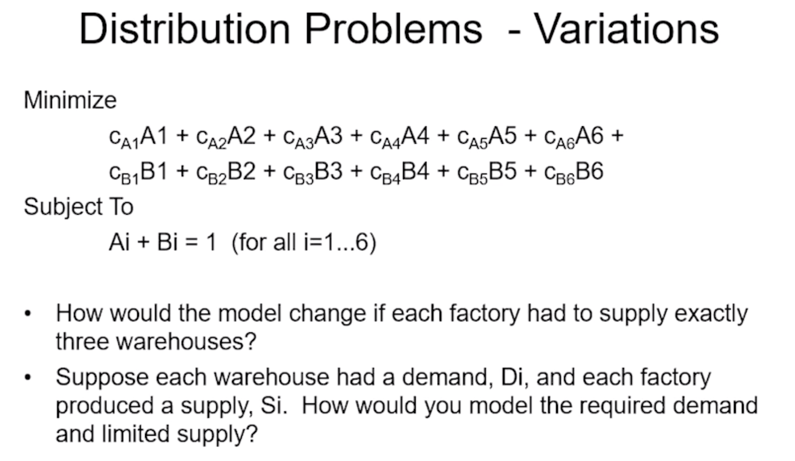
Activity 3: Distribution Problem
Rusty introduced an example of LPs for distribution problems (below). Answer the two questions he posed in a slide or two.

Slide 8
Activity 3 solution:
For the first and second question we would need to add new constraints.
Subject To would now look like:
Ai + Bi + Ci = 1 (for all i=1…6)
Each entry would now have:
Ai + Bi = Di (for all i=1…6) Ai + Bi = Si (for all i=1…6)

Slide 9
Activity 4: LP / Integer in R
As we know well by now, a very useful and critical capability to be able to understand the problem and to be able to research potential solutions to solve the problem. Your goal here is to use R to solve the manufacturing problem below (same one you have already solved using Excel Solver. Hint: you will first have to look for a package that will handle this task.
A slide or two will be good here. Be sure and include your commented code and what package you used.
https://www.oag.com/on-time-performance-dashboards

Slide 10
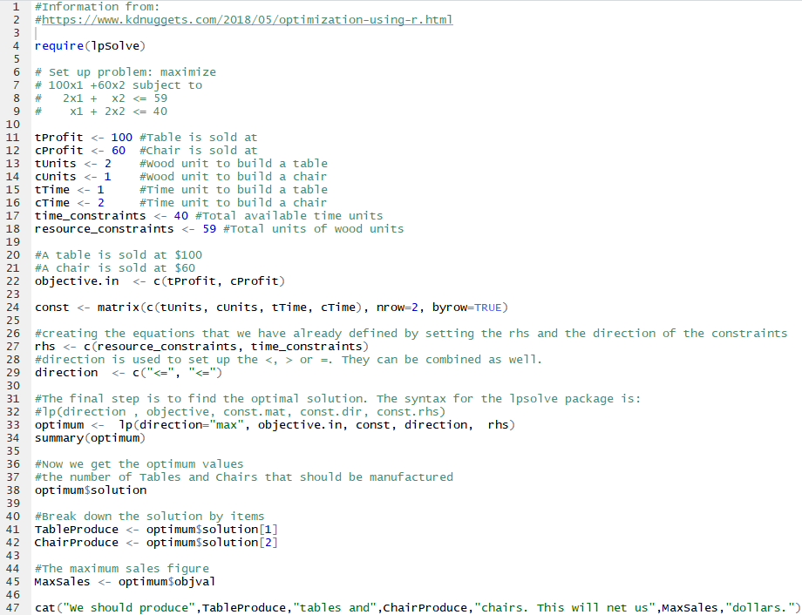
Activity 4 solution: I used the lpSolve and got a solution: We should produce 26 tables and 7 chairs. This will net us 3020 dollars.

